Slide 1
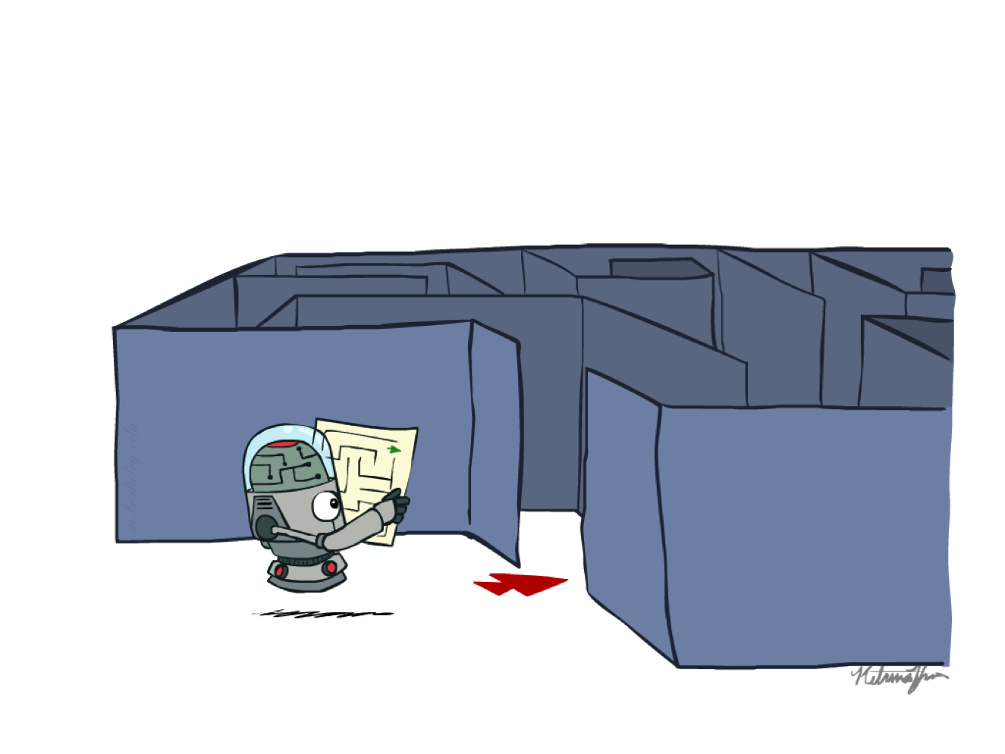



BITS Pilani
Pilani Campus
(some slides adapted from Dan Klein and Pieter Abbeel http://aima.cs.berkeley.edu/)
DSE CL 557 - Artificial and Computational Intelligence
#5. Heuristic Functions
Sunday, September 27, 2020
Dr. Saikishor Jangiti

Slide 2
Today
Optimality of A* graph search
Memory Bounded Heuristic Search
Heuristic Accuracy & Algorithm performance
Admissible heuristics from relaxed problems
Pattern databases
Experience
Reference: Chapter 3.5 & 3.6 from AI: A modern approach (Russell, Norvig)

Slide 3
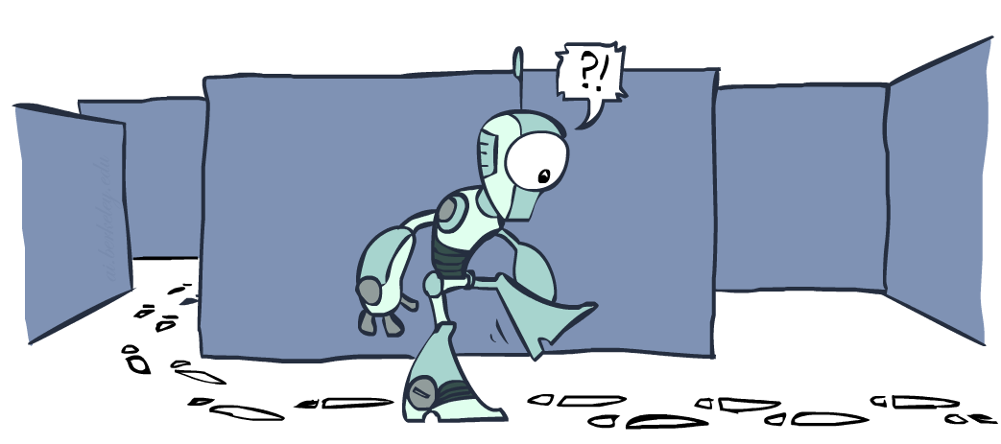
Graph Search

Slide 4
Tree Search: Extra Work!
Failure to detect repeated states can cause exponentially more work.
State Graph
Search Tree

Slide 5
Graph Search
In BFS, for example, we shouldn’t bother expanding the circled nodes (why?)
S
d
e
p
b
c
e
h
r
q
a
a
h
r
p
q
f
p
q
f
q
c
G
q
c
G
a
a

Slide 6
Graph Search
Idea: never expand a state twice
How to implement:
Tree search + set of expanded states (“closed set”)
Expand the search tree node-by-node, but…
Before expanding a node, check to make sure its state has never been expanded before
If not new, skip it, if new add to closed set
Important: store the closed set as a set, not a list
Can graph search wreck completeness? Why/why not?
How about optimality?

Slide 7
A* Graph Search Gone Wrong?
State space graph
Search tree
A
S (0+2)
1
S
1
C
h=4
h=1
A (1+4)
B (1+1)
h=2
1
2
B
3
C (2+1)
C (3+1)
h=1
G
G (5+0)
G (6+0)
h=0

Slide 8
Consistency of Heuristics
Main idea: estimated heuristic costs ≤ actual costs
Admissibility: heuristic cost ≤ actual cost to goal
h(A) ≤ actual cost from A to G
Consistency: heuristic “arc” cost ≤ actual cost for each arc
h(A) – h(C) ≤ cost(A to C)
Consequences of consistency:
The f value along a path never decreases
h(A) ≤ cost(A to C) + h(C)
A* graph search is optimal
A
1
C
h=4
h=2
h=1
3
G

Slide 9

Optimality of A* Graph Search

Slide 10
Optimality of A* Graph Search
Sketch: consider what A* does with a consistent heuristic:
Fact 1: In tree search, A* expands nodes in increasing total f value (f-contours)
Fact 2: For every state s, nodes that reach s optimally are expanded before nodes that reach s suboptimally
Result: A* graph search is optimal
…
f ≤ 1
f ≤ 2
f ≤ 3

Slide 11
Optimality
Tree search:
A* is optimal if heuristic is admissible
UCS is a special case (h = 0)
Graph search:
A* optimal if heuristic is consistent
UCS optimal (h = 0 is consistent)
Consistency implies admissibility
In general, most natural admissible heuristics tend to be consistent, especially if from relaxed problems

Slide 12

A*: Summary

Slide 13

A*: Summary
A* uses both backward costs and (estimates of) forward costs
A* is optimal with admissible / consistent heuristics
Heuristic design is key: often use relaxed problems

Slide 14
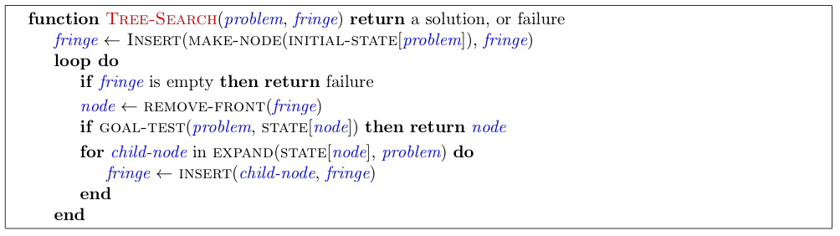
Tree Search Pseudo-Code

Slide 15
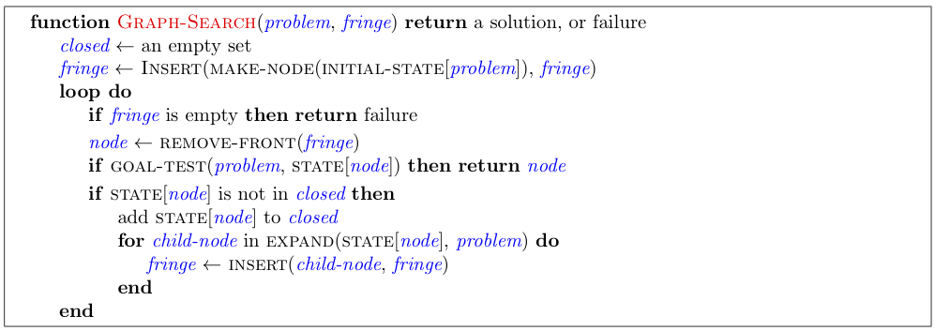
Graph Search Pseudo-Code

Slide 16
Optimality of A* Graph Search
Consider what A* does:
Expands nodes in increasing total f value (f-contours) Reminder: f(n) = g(n) + h(n) = cost to n + heuristic
Proof idea: the optimal goal(s) have the lowest f value, so it must get expanded first
…
f ≤ 1
There’s a problem with this argument. What are we assuming is true?
f ≤ 2
f ≤ 3

Slide 17



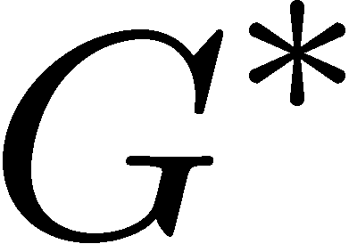

Optimality of A* Graph Search
Proof:
New possible problem: some n on path to G* isn’t in queue when we need it, because some worse n’ for the same state dequeued and expanded first (disaster!)
Take the highest such n in tree
Let p be the ancestor of n that was on the queue when n’ was popped
f(p) < f(n) because of consistency
f(n) < f(n’) because n’ is suboptimal
p would have been expanded before n’
Contradiction!

Slide 18
Space drawback of A*
A* usually runs out of space long before it runs out of time.
Because it keeps all generated nodes in memory (as do all GRAPH-SEARCH algorithms)
For this reason, A* is not practical for many large-scale problems.
There are, however, algorithms that overcome the space problem without sacrificing optimality or completeness, at a small cost in execution time.

Slide 19
Memory-bounded heuristic search
IDA* - to reduce memory requirements for A*
ITERATIVE-DEEPENING to the heuristic search context
Cutoff is f-cost (g+h)
At each iteration, the cutoff value is the smallest f-cost of any node that exceeded the cutoff on the previous iteration

Slide 20
The effect of heuristic accuracy on performance
One way to characterize the quality of a heuristic is the effective branching factor b*.
If the total number of nodes generated by A* for a particular problem is N and the solution depth is d, then b* is the branching factor that a uniform tree of depth d would have to have in order to contain N + 1 nodes. Thus,
N + 1 = 1 + b* + (b*)²+……..+(b*)^{d}

Slide 21
Effective branching factor
For example, if A* finds a solution at depth 5 using 52 nodes, then the effective branching factor is 1.92.
A well-designed heuristic would have a value of b* close to 1, allowing fairly large problems to be solved at reasonable computational cost.

Slide 22
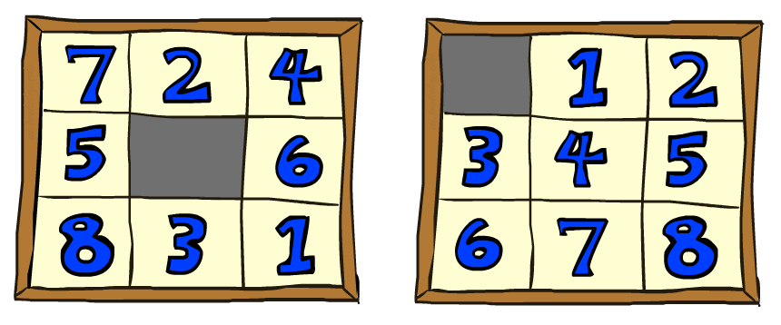
8 puzzle
Start State
Goal State
Consider 2 heuristics
h1 = the number of misplaced tiles
h2 = the sum of the Manhattan distances of the tiles from their goal positions

Slide 23
Effective branching factor
Data are averaged over 100 instances of the 8 puzzle for each of various solution lengths d.

Slide 24
h2 dominates h1
Is h2 always better than h1
Yes
from the definitions of the two heuristics that, for any node n, h2(n) > h1(n)
h2 dominates h1
Domination translates directly into efficiency
A* using h2 will never expand more nodes than A* using h1

Slide 25

Which heuristic to use
If a collection of admissible heuristics h1 . . . hm is available for a problem and none of them dominates any of the others

Slide 26
Generating admissible heuristics from relaxed problems
A problem with fewer restrictions on the actions is called a relaxed problem.
The state-space graph of the relaxed problem is a supergraph of the original state space because the removal of restrictions creates added edges in the graph.
the cost of an optimal solution to a relaxed problem is an admissible heuristic for the original problem

Slide 27
Relaxed problems
For example, if the 8-puzzle actions are described as
A tile can move from square A to square B if
A is horizontally or vertically adjacent to B and B is blank,
we can generate three relaxed problems by removing one or both of the conditions:
(a) A tile can move from square A to square B if A is adjacent to B.
(b) A tile can move from square A to square B if B is blank.
(c) A tile can move from square A to square B.

Slide 28
Pattern databases
Sub problem of the 8-puzzle instance

Slide 29
Disjoint pattern databases
The idea behind pattern databases is to store these exact solution costs for every possible sub-problem instance
The choice of 1-2-3-4 is fairly arbitrary; we could also construct databases for 5-6-7-8, for 2-4-6-8, and so on
With disjoint pattern databases,
it is possible to solve random 15-puzzles in a few milliseconds
the number of nodes generated is reduced by a factor of 10,000 compared with the use of Manhattan distance.
For 24-puzzles, a speedup of roughly a factor of a million can be obtained.

Slide 30
Learning heuristics from experience
"Experience" means solving lots of 8-puzzles, for instance.
Each optimal solution to an 8-puzzle problem provides examples from which h(n) can be learned.
Store features that might be predictive of solution cost from a given node n
○ E.g., x1(n) = “number of misplaced tiles”
○ E.g., x2(n) = “number of pairs of adjacent tiles that are not adjacent in goal state”
Store these values while solving each variant
How to combine x1(n) , x2(n) to predict h(n)
■ Linear Combination: h(n) = c1 x1(n) + c2 x2(n)
■ Can be neural nets, decision trees
However, such h(n) is not guaranteed to be admissible or consistent

Slide 31
Heuristics in Deep blue
Evaluation function had over 8000 features, many of them describing highly specific patterns of pieces
“opening book” of about 4000 positions was used
Database of 700,000 grandmaster games from which recommendations could be extracted
Used a large endgame database of solved positions containing all positions with five pieces and many with six pieces
Various pruning heuristics are used to reduce the effective branching factor to less than 3 (compared with the actual branching factor of about 35)

Slide 32
Thank You
?
Any more Queries
Required Reading:

